Slide 1
Neural Data Science Course

Slide 2
PART I: Error bars on tuning curves

Slide 3
Reiterate Bootstrapping
Let observed distribution stand in for the (unobserved) real distribution
There is noise on each bin
Treat each bin as if it was a random drawing from bins you could have gotten
Sample with replacement to get alternative outcome of experiment
Get distribution from this

Slide 4
MATLAB: how to sample with replacement
inds=1+floor(rand(size(angle))*length(angle));

Slide 5
For Tuning Curves
The regular tuning curve
Alternative tuning curves
(for each bootstrap run)

Slide 6
Confidence bounds
Do it 1000 times (or 10k times)
For each bin, discard bottom 2.5% and top 2.5%
Remaining range =95% confidence interval

Slide 7
Now Do It
Edit BootstrapErrorBars.m
You faster? Do this for neurons with very low firing rates. How do confidence bounds depend on firing rates? Why?

Slide 8
Caveats
Need enough bins
Bins should be independent
Details matter: approximate hypothetical experiments

Slide 9
Why bootstrap = life skill
Replaces my time with my computers
Many desirable properties (e.g. no need to assume probability distribution)
Works on just about anything

Slide 10
PART II: Fit Arbitrary function

Slide 11
Fitting functions
We have a function (e.g. from a model)
We want to know for which parameters fit is best

Slide 12
Example function for tuning curve

Slide 13
Measure fit quality

Slide 14
Fitting in Matlab
Write one function EvaluateScoreCosExp
Which, predicts for each bin for a set of parameters
Then calculate probability of the spikes given this model
Then let matlab fminsearch figure out which parameters (p1, p2, p3) are optimal
fminsearch(@evaluateScoreCosExp, start,[],spikes(nNeuron,:),angle)
Then plot the function you just fit

Slide 15
Now Do It
Edit evaluateScoreCosExp.m and FitTuningCurve.m
You faster? Bootstrap the results of fitting the tuning curve. How precisely do we know the preferred orientation? For this and other neurons, what determines the uncertainty about the tuning properties?

Slide 16
Caveats
Always look at the results
Does not always converge for non-convex problems (check global optimization literature)

Slide 17
Why function fitting = life skill
Ultimate glue between experiment and theory
Quantify whatever your eyes see
Fit anything. Molecular biology, psychophysics, physiology, fMRI

Slide 18
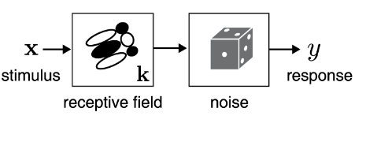
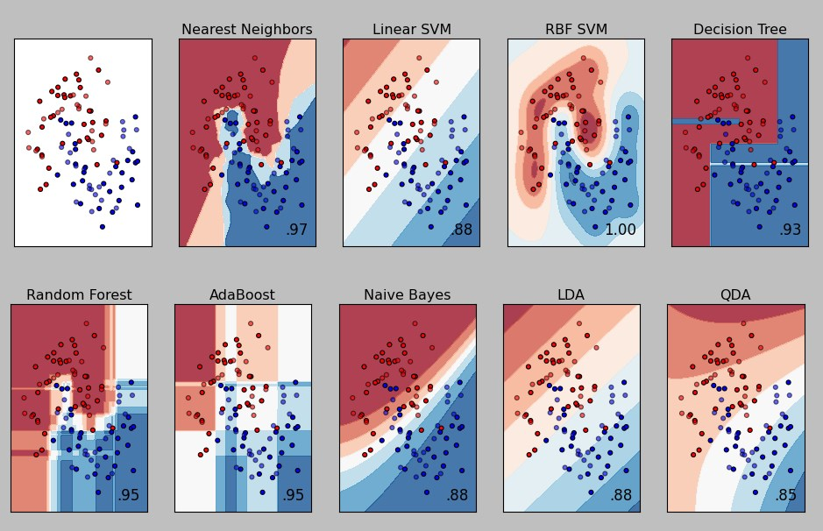
PART III: Machine learning to predict neural firing
vs

Slide 19
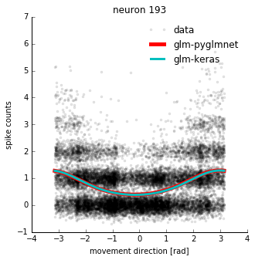
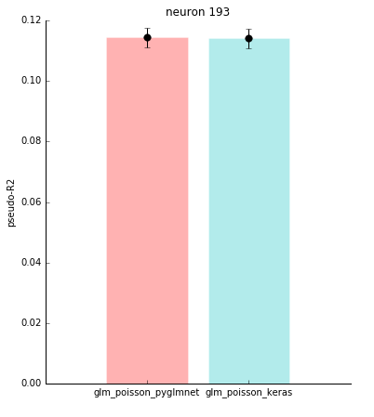
GLM=trivial neural network
Linear with exponential activation
Poisson scoring

Slide 20
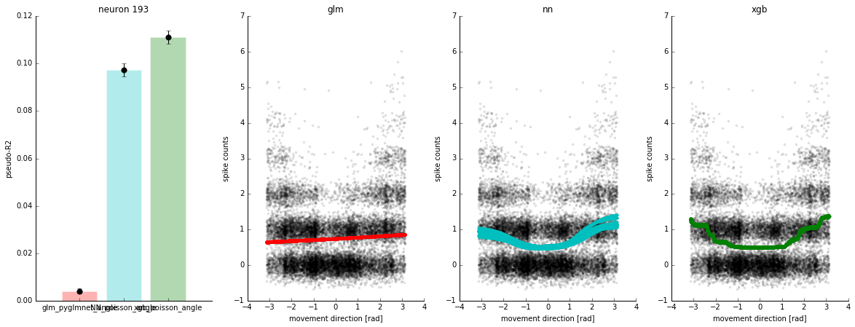
Feature engineering: only angles

Slide 21
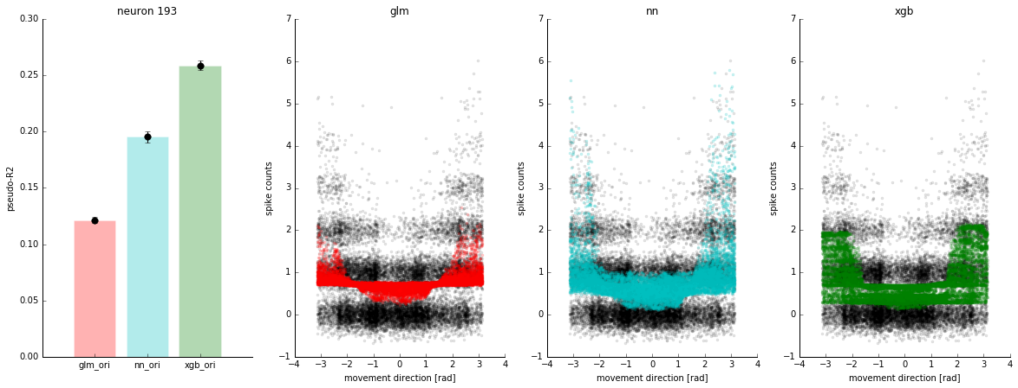
Now, do some machine learning with position and velocity
Multi-layer NN
XGboost

Slide 22
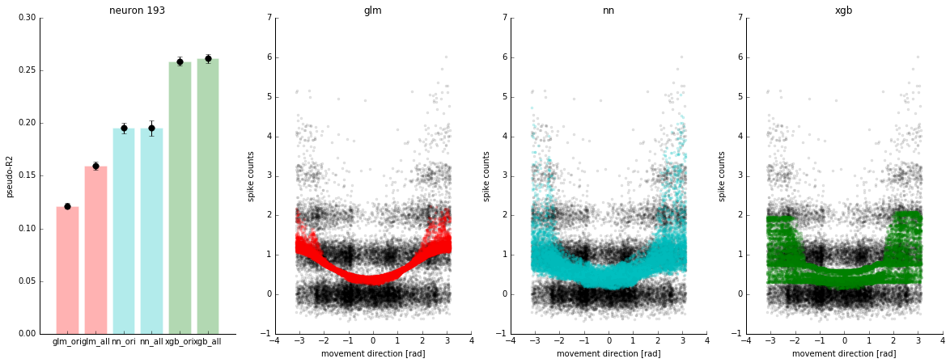
Can feature engineering rescue GLM?
Add speed, cosine, sine

Slide 23
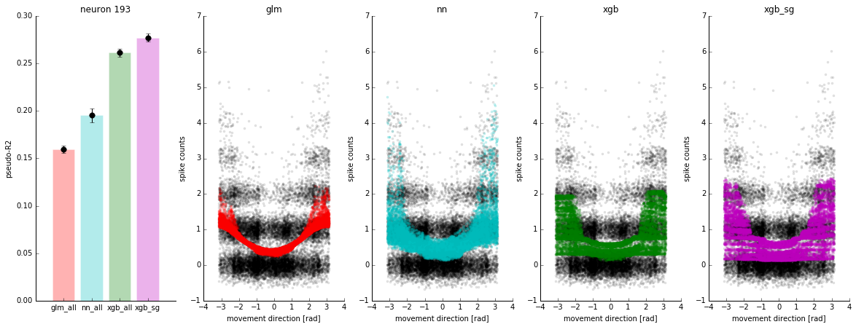
Ensemble method (combine all)

Slide 24
Why it matters
If functions are nonlinear – what do we learn from linearization
Deal with worry about missing features
Also, decode/ classify better

Slide 25
MATLAB: use python for ML
But we have:
X= matrix of regressors
Y= spike train
Treebagger does random forests but with mean squared error scoring
b = TreeBagger(200,X,Y,'Method','R','OOBPred','On',...
'MinLeafSize',leaf(i));
oobError(b)
Compare with mseTotalConst and mseTotalLinearRegression

Slide 26
Now Do It
Edit MachineLearningPredictions.m
You faster? How well does this finding generalize across neurons? Why are the R^2 so small?

Slide 27
Why machine learning = life skill
A way to ask if there is information
A way of letting the computer do the feature engineering.
If the brain is nonlinear and not in a simple way there is no alternative.

Slide 28
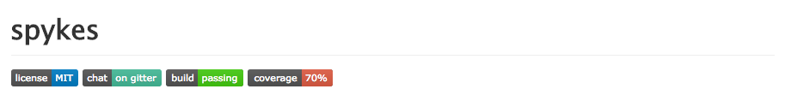
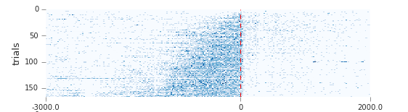
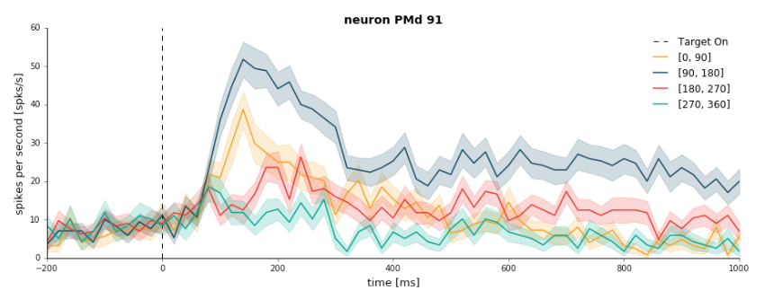


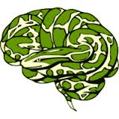

http://github.com/KordingLab/spykes
Rasters, PSTHs, tuning curves, decoding in ~10 lines of code!
Professional software engineering standards Inspired by recent successes in data science and neuroimaging
Reach out: twitter.com/desipoika
http://pavanramkumar.github.io

